Slide 1
UNIVERSITY OF COMPUTER STUDIES(MANDALAY)
Personal Python Flask Who is
Who in Myanmar Mighty Geo
Team
Internship Program
2017-2018 Academic Year

Slide 2
Supervisor-Daw Hnin Yu Yu Win
Member
Mg Arthur Min Sein(5cs-84)
Ma War War Myint(5cs-83)
Ma Phue Thinzar Maw(5cs-82)
Ma Tin Tin Win(5cs-81)
Ma Thiri Mon(5cs-86)
Ma Shwe Yee Ko Ko(5cs-85)

Slide 3
ACKNOWLEDGEMENT
First of all ,we would like to respectfully thank and appreciate to our rector U Kyaw Zwa Soe,Rector of UCS(Mdy) ,who gives us this opportunities to develop this project .
Secondly, we would like to express to thank ,Dr. Daw San San Tint, Pro-Rector of UCS(Mdy).
Then, thank has been extended to Dr. Daw Aye Aye Chaw,Head of Faculty Of Computer Science .
And Then, also thank has been extended to Dr. Daw Mya Thidar Kyaw , Chaw,Head of Faculty Of Information Science .
Then also greatly thanks to U Ravi Chhabra , CEO of Geo Mandalar Co.,Ltd , for his patient training to gain experience in modern software development and trust to give us .
And we are deeply thankful to our supervisor ,Daw Hnin Yu Yu Win (Faculty of Computer Science), for her valuable guidance , encouragements ,patient supervision and suggestions on the accomplishement of this project.
We especially thanks to our parents and all our friends for providing encouragement and giving us a great support during internship program.

Slide 4
ABSTRACT
This project will present that shows about famous people who live in Myanmar.
Users can get easily information on their fingertips.
Who Is Who In Myanmar is a type of only information page that helps to provide the details information of famous people in Myanmar.
They have special features like unusual standard of living or special skills that are not found in common people.
That is can be said that in society they are different from the common people.
Among of them, this project shows such as Politicians ( Eg: Daw Aung San Su Kyi), Business leaders( Eg: U Khin Shwe) , Celebrity(Eg : Hlwan Paing).
To form our app design, we had to take some templates such as Material Design Lite(MDL) and Materialize CSS .And then coding and design were merged into a useful app.
The part of documentation is to show how our app had worked step by steps.Finally, Who Is Who In Myanmar is released as a link for users to be used easily.
v

Slide 5
OBJECTIVES
To search easily and quickly the user’s desire data.
To know the actions and steps of famous person.
To learn about the famous person.
To decrease search time.
To help the people who want to know the details of Myanmar famous people.
To acquire knowledge.

Slide 6
INTRODUCTION
Nowadays, Mobile phones are very useful for everyone to communicate with each other.
No long distance charges have applications like games and calendar to help organize schedules.
Not only adults but also children use mobile phones.So they are becoming an important part of our everyday life.
Nowadays, reducing the men’s physical effort with the help of latest devices and technologies is on demand.
Besides, it is easier to find information and facts on the Internet than to find information using Newspapers, Journals etc.,
Everyone has at least one idol.
We can find easily about the famous person who we want to know in this app .
This is divided into three parts .They are Politicians, Celebrities, Business Leaders.
The project named “Who Is Who In Myanmar” is aimed to find information about the famous people who you want to find.
You can easily search birth date, native name, address , occupation etc.., in this app .
Our project implemented by Python with Flask framework.

Slide 7
SQL Alchemy
SQL Alchemy is the Python SQLite toolkit and Object Relational Mapper that gives application developers the full power and flexibility of SQLite. It provides a full suite of well known enterprise-level persistence patterns, designed for efficient and high-performing database access, adapted into a simple and Pythonic domain language.
Flask
Flask is a micro web framework written in Python. It is classified as a microframework because it does not require particular tools or libraries. ... Applications that use the Flask framework include Pinterest, LinkedIn, and the community web page for Flask itself.

Slide 8
HEROKU
Heroku is a cloud platform that lets companies build, deliver, monitor and scale apps — we're the fastest way to go from idea to URL, bypassing all those infrastructure headaches.

Slide 9
Git-Hub
Git-Hub is a code hosting platform for version control and collaboration. It lets you and others work together on projects from anywhere. It is simply a software that helps you manage your source code.That means each change that you make to a source code is recorded in its history.So it can also be called as Source Code managemnt system.
Background of the System
We use Git-Hub as a version control system to get good communication among designers and developers. We use Sql Alchemy as a Python SQLite toolkit to get the full power and flexibility of SQLite. Our Web Application is implemented by using web design development frameworks,Python,Flask,SQL Alchemy and Heroku. Web design development frameworks are as follows:
HTML ,
CSS,
JAVASCRIPT,
MATERIALIZE ,
MATERIAL DESIGN LITE

Slide 10
HTML
HTML – HyperText Markup Language – is the language for website creators creating web pages. Strictly speaking, it’s not the only language webmasters should know – far from it – but definitely the most important one. Without knowing it (or XHTML, its variation) nobody can create as much as one webpage looking even slightly prettier than a page of unformatted plain text. The WWW as we know it would never exist without the invention of HTML.
CSS
Cascading Style Sheets, fondly referred to as CSS, is a simple design language intended to simplify the process of making web pages presentable.CSS is easy to learn and understand but it provides powerful control over the presentation of an HTML document. Most commonly, CSS is combined with the markup languages HTML or XHTML.

Slide 11
JAVASCRIPT
Javascript (JS) is a scripting languages, primarily used on the Web. It is used to enhance HTML pages and is commonly found embedded in HTML code. JavaScript is an interpreted language. Thus, it doesn't need to be compiled. JavaScript renders web pages in an interactive and dynamic fashion. This allowing the pages to react to events, exhibit special effects, accept variable text, validate data, create cookies, detect a user’s browser, etc.
MATERIALIZE CSS
Materialize is basically Css framework which is used to create responsive websites. Materialize framework is basically built on google’s material design concept. Materialize framework is created with HTML, CSS and JavaScript, Anyone having the basic knowledge of HTML, CSS and JavaScript can learn easily. Materialize provides you ready made rich layouts, animations and many more powerful UI.

Slide 12
MATERIAL DESIGN LITE
Material Design Lite is built to provide a lightweight and basic set of Material Design components and templates for web sites. The project does not intend to provide structures to create all possible UX needs, but to provide a low-friction Material Design implementation you can build on.
PYTHON
Python is an interpreted, object-oriented, high-level programming language with dynamic semantics. Its high-level built in data structures, combined with dynamic typing and dynamic binding, make it very attractive for Rapid Application Development, as well as for use as a scripting or glue language to connect existing components together. Python's simple, easy to learn syntax emphasizes readability and therefore reduces the cost of program maintenance. Python supports modules and packages, which encourages program modularity and code reuse. The Python interpreter and the extensive standard library are available in source or binary form without charge for all major platforms, and can be freely distributed.

Slide 13
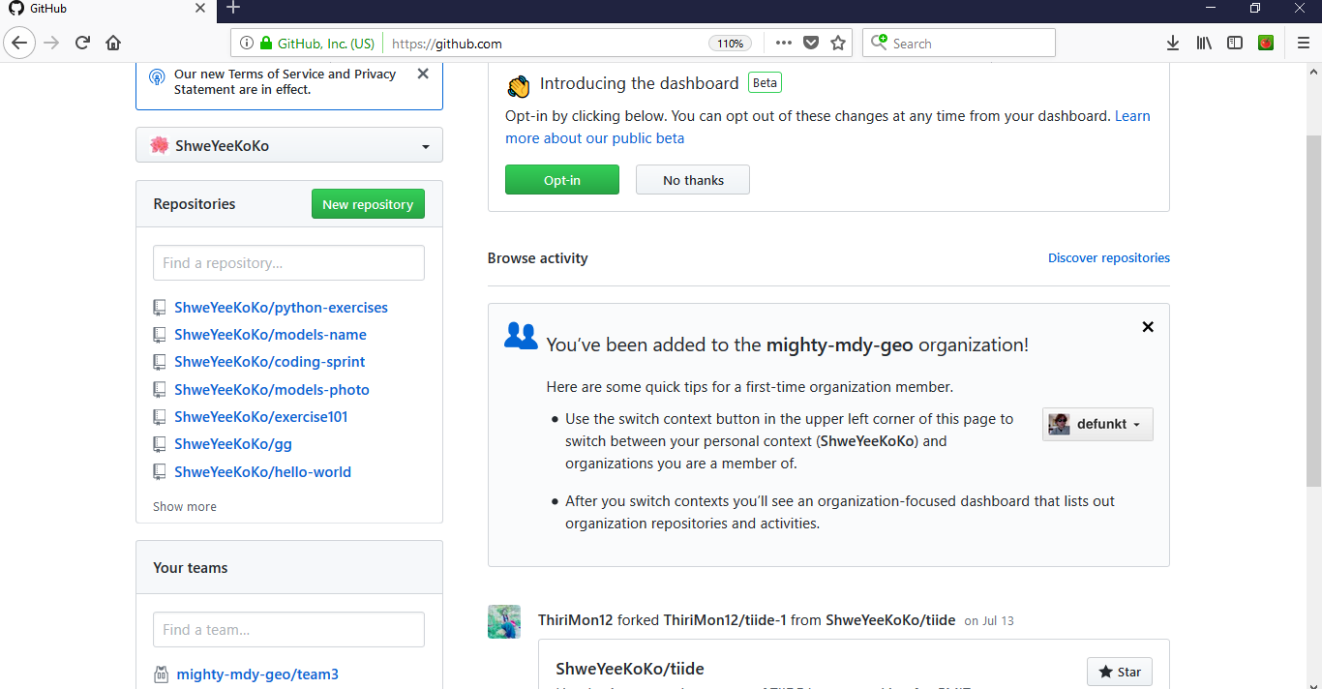
Making Github Account
Do Github tutorial
Create Repository

Slide 14
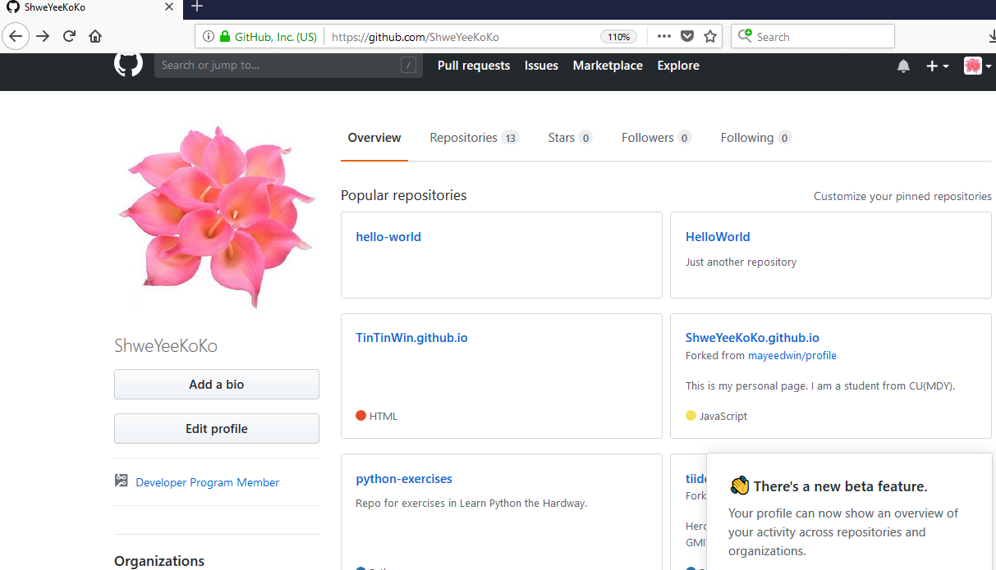

Slide 15
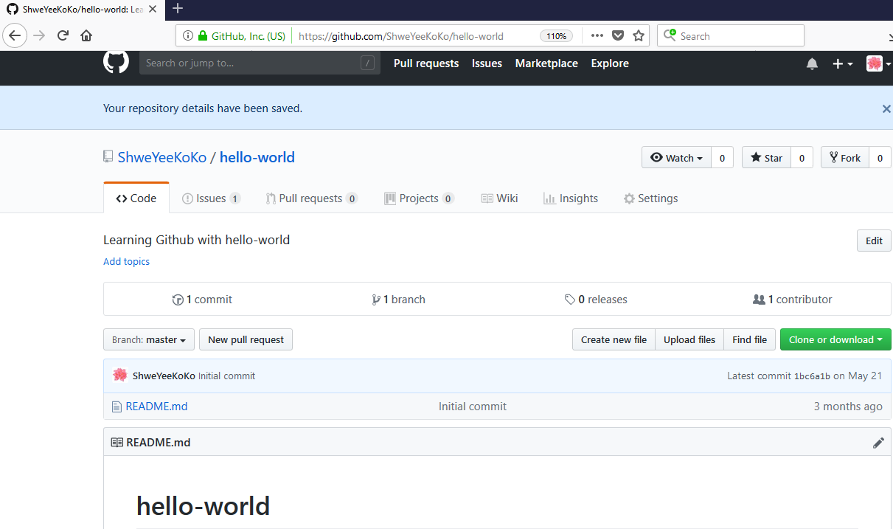

Slide 16
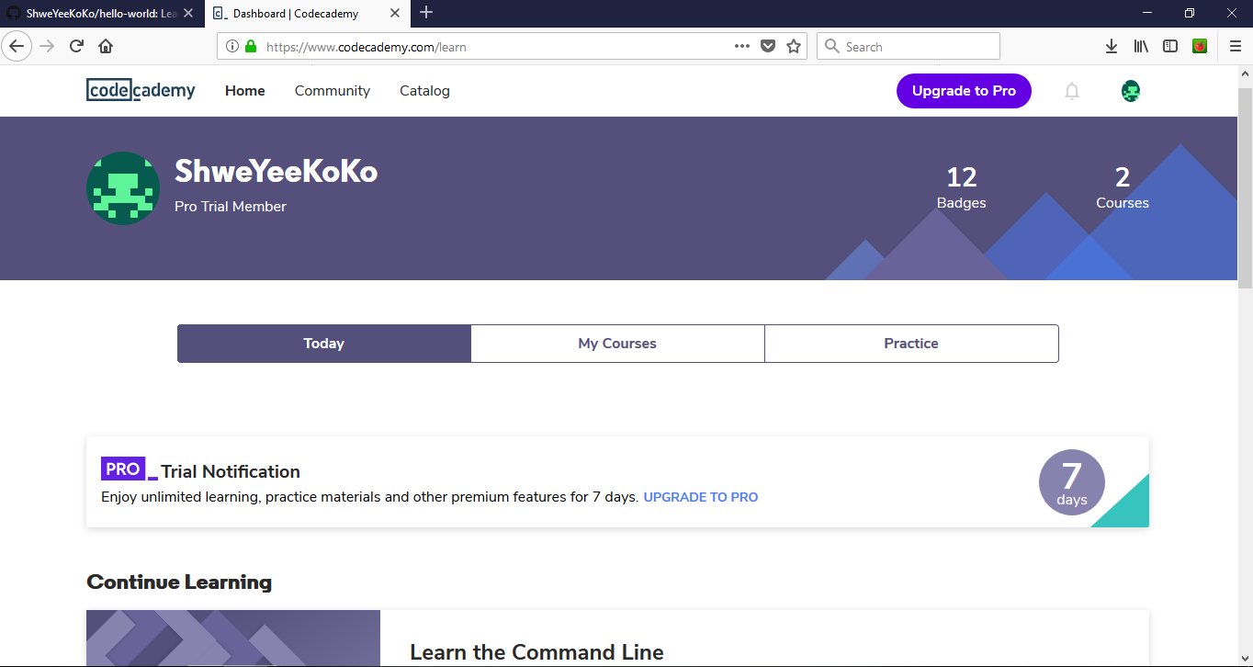
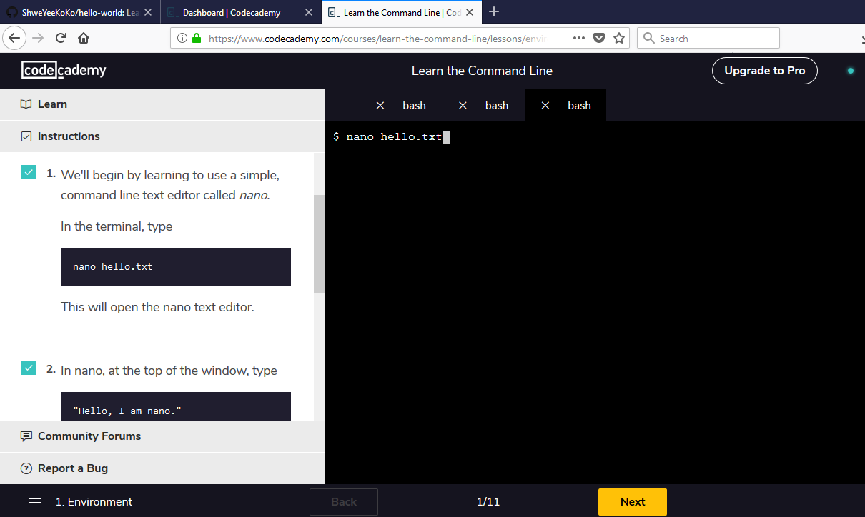
Making Code Academy Accoount
Making Command Line Tutorial

Slide 17
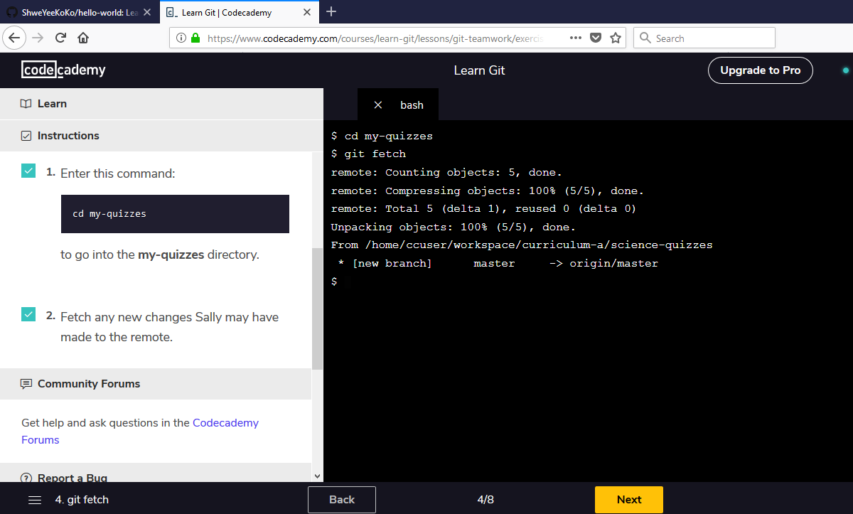
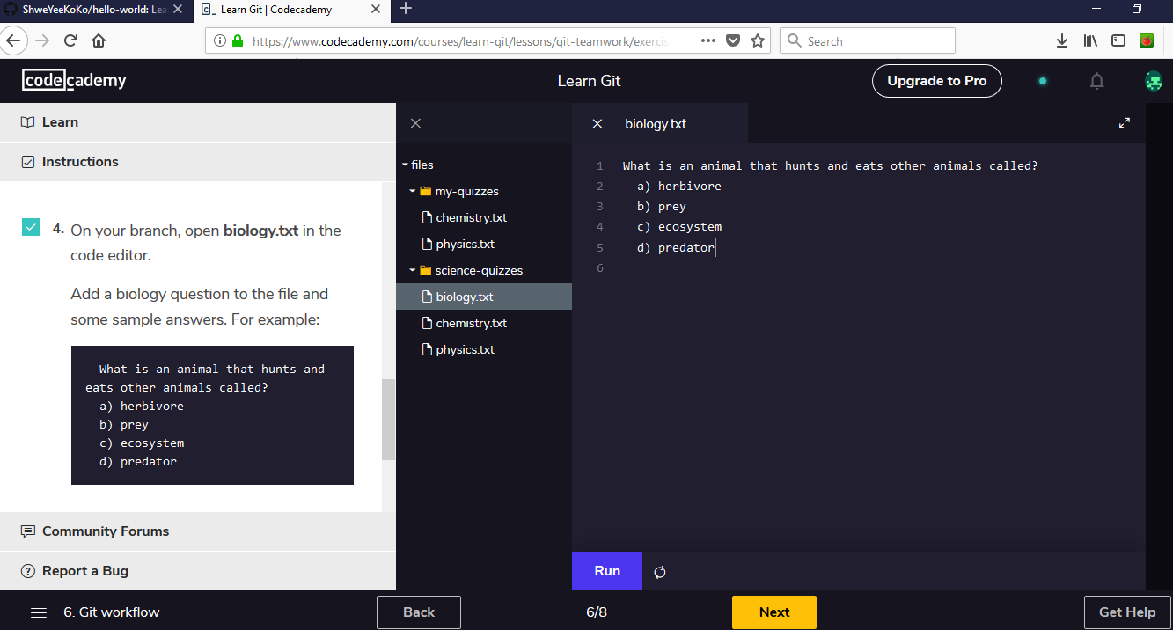
Learn Git and Command Line

Slide 18
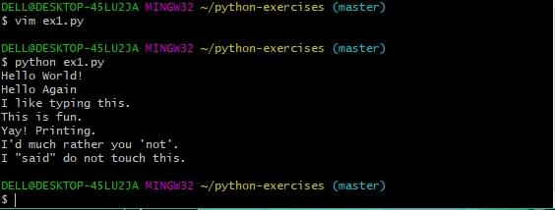
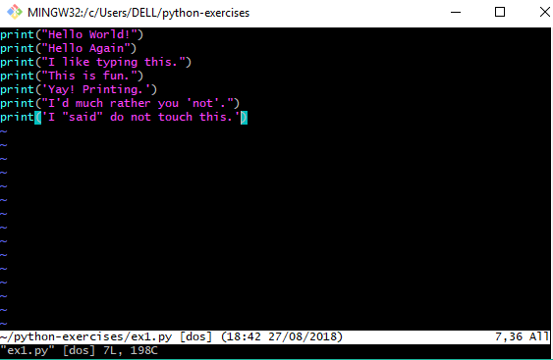
Learning Python Program
Example-1

Slide 19
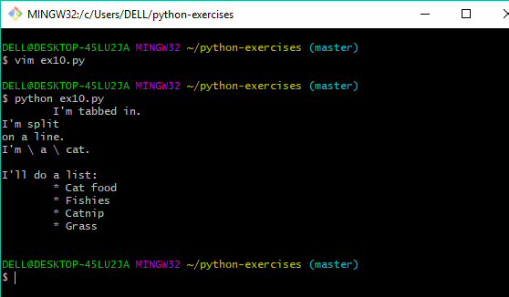
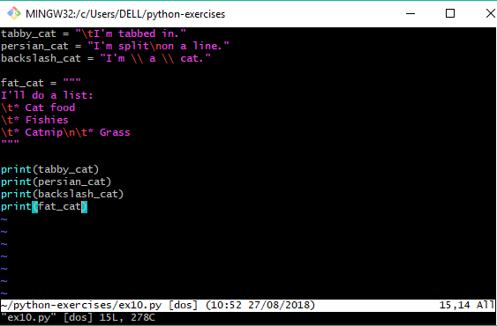
Learning Python Program
Example-10

Slide 20
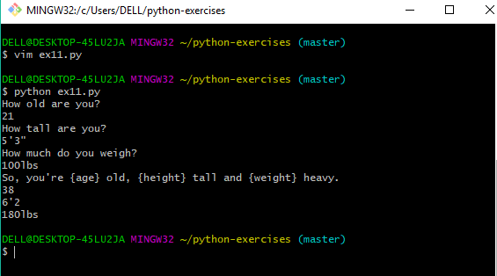
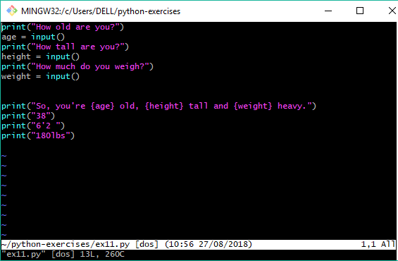
Learning Python Program
Example-11

Slide 21
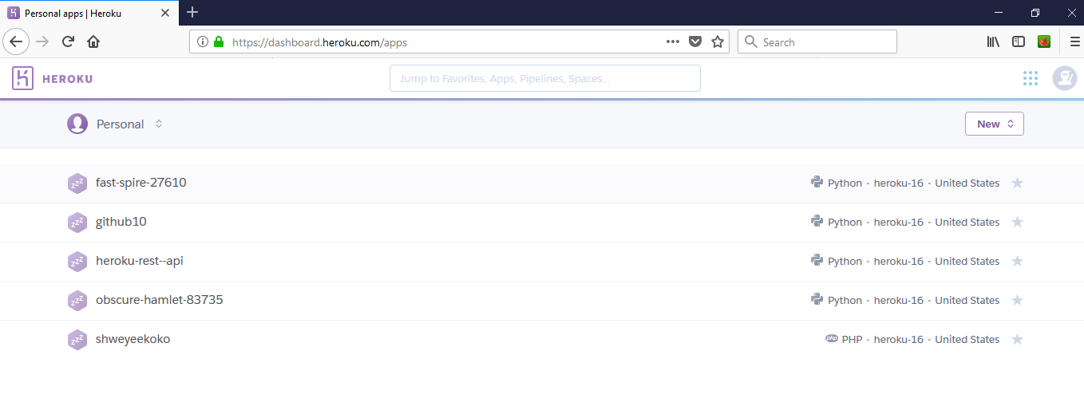
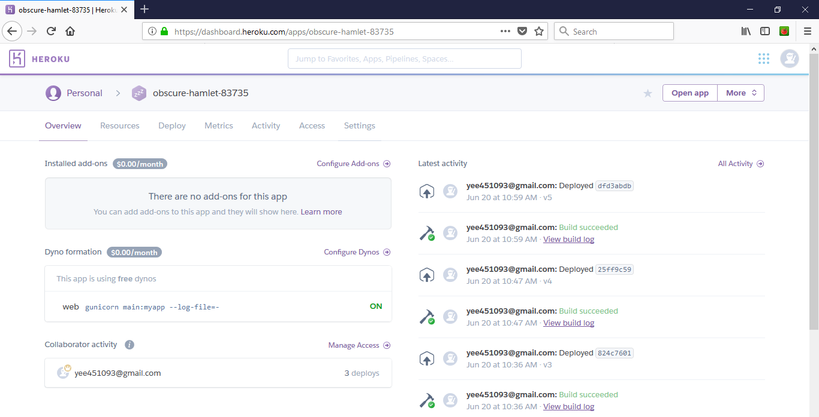
Create Heroku App Account
Create App on Heroku
Deploy App with github on Heroku
View output from Heroku

Slide 22
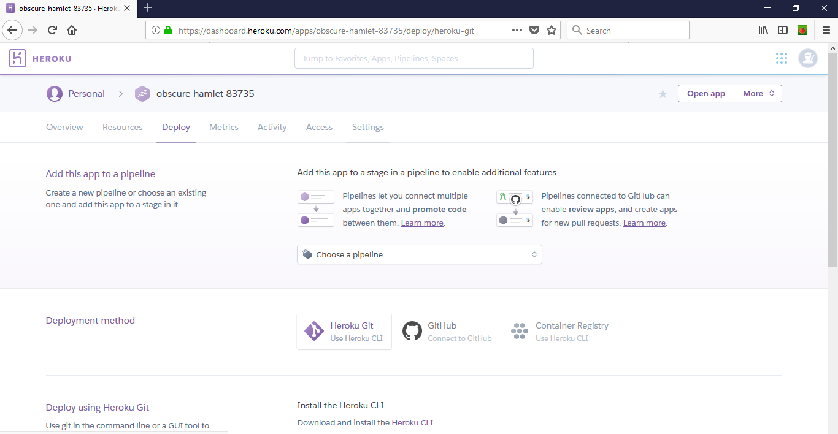
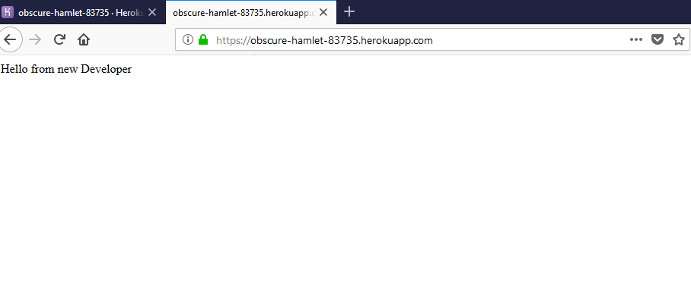
Apply Heroku App

Slide 23
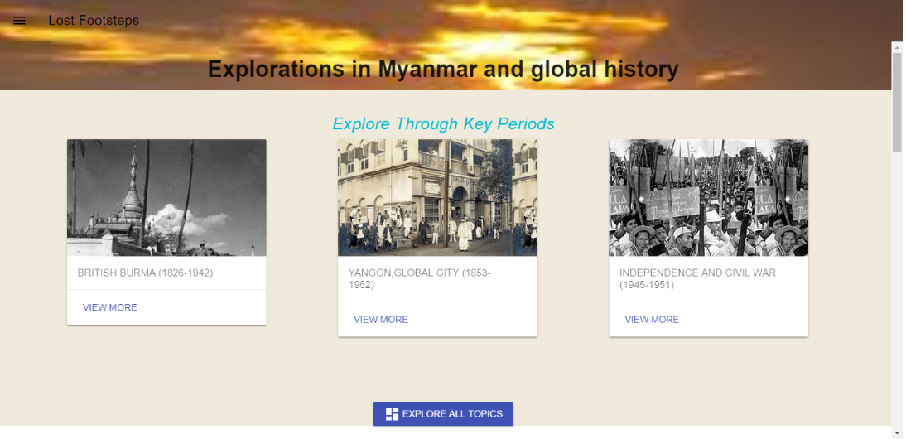
UI-UX Design-1
Materialize Design

Slide 24
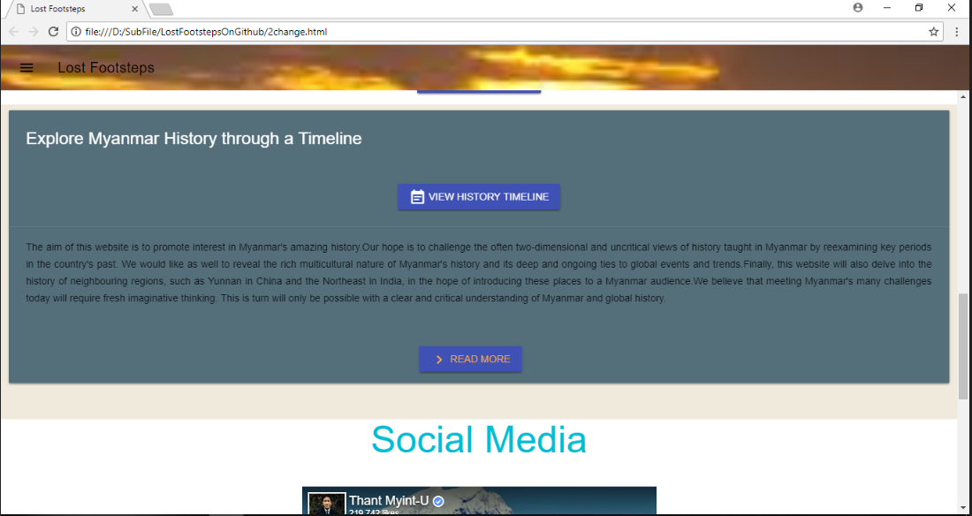

Slide 25
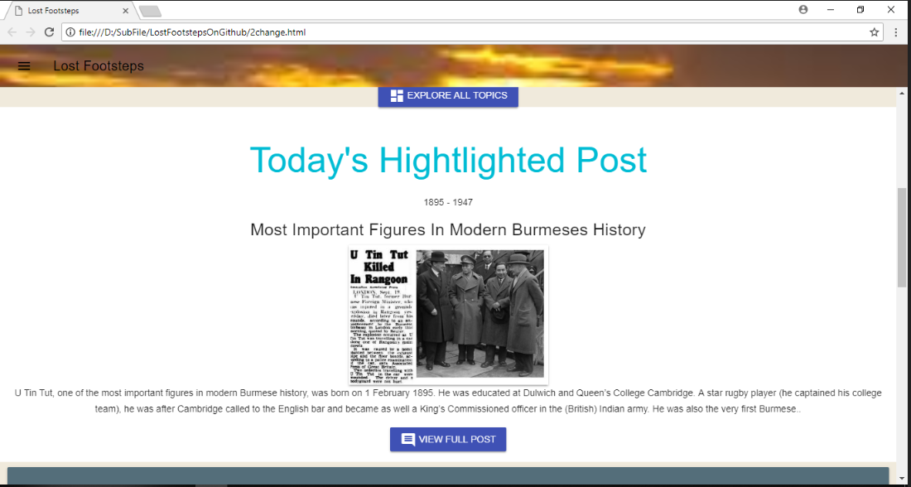

Slide 26
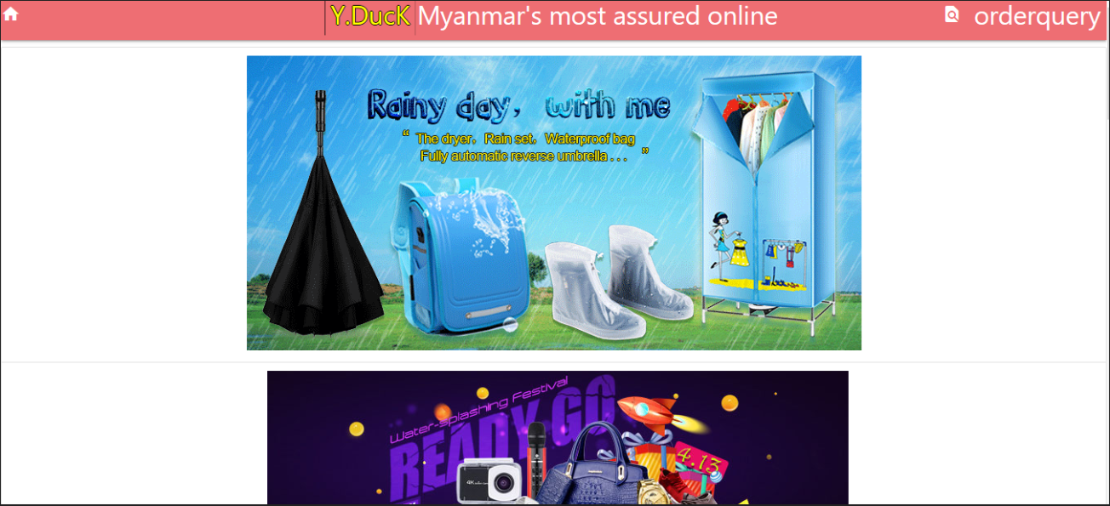
UI-UX Design-2
Materialize Design

Slide 27
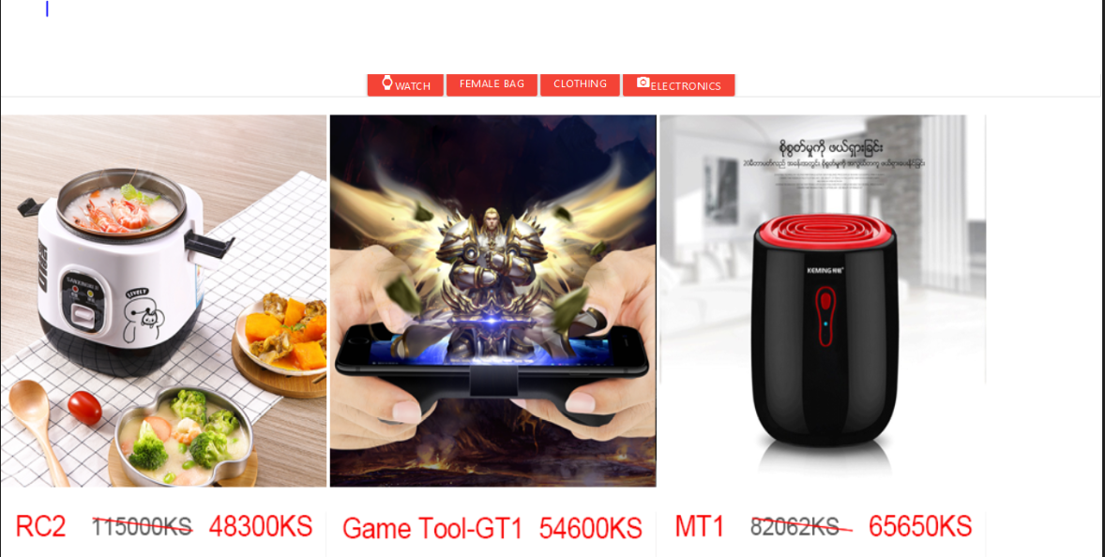

Slide 28
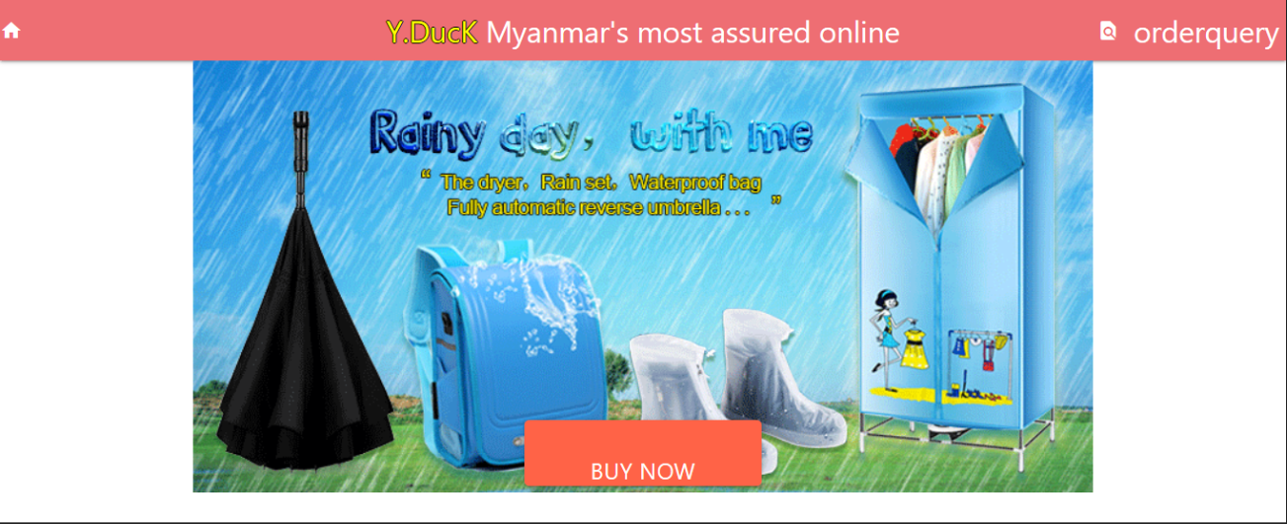

Slide 29
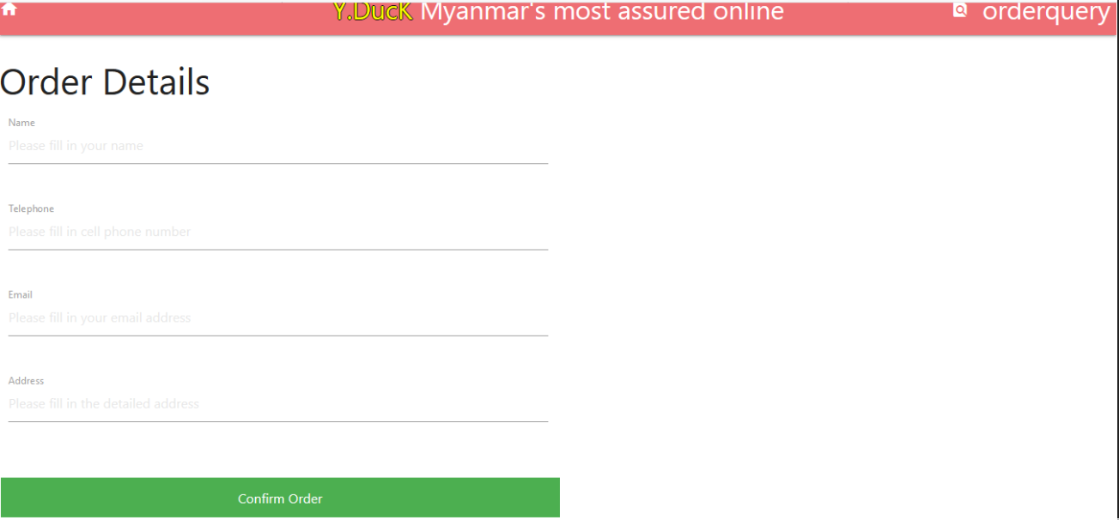

Slide 30
Design
Web Architecture
/
Home
Politician
Business Leader
Celebrity
About
Search
Detail Profile
Detail Profile
Detail Profile
Result
Detail Profile

Slide 31
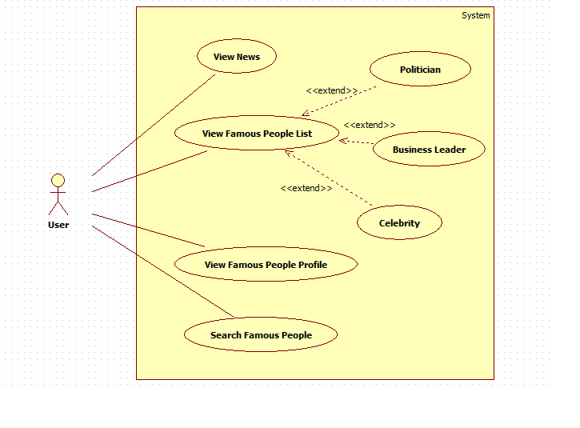
Usecase Diagram

Slide 32
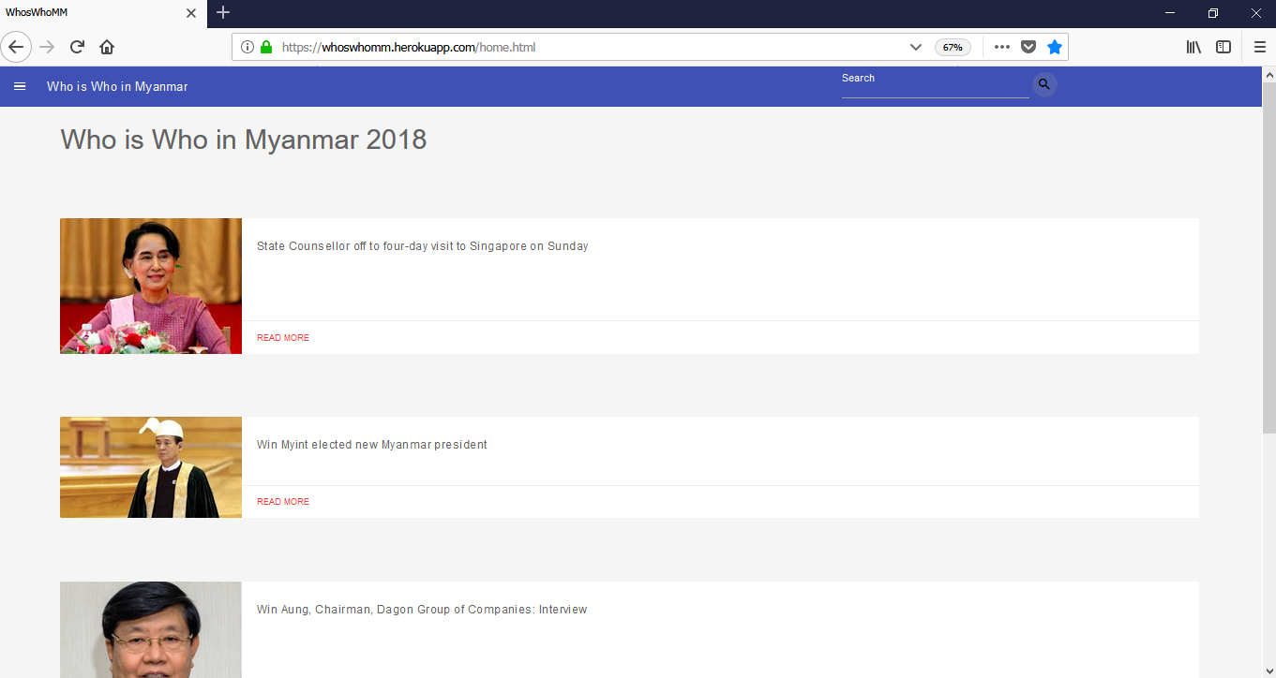
User Interface Design of Home Page

Slide 33
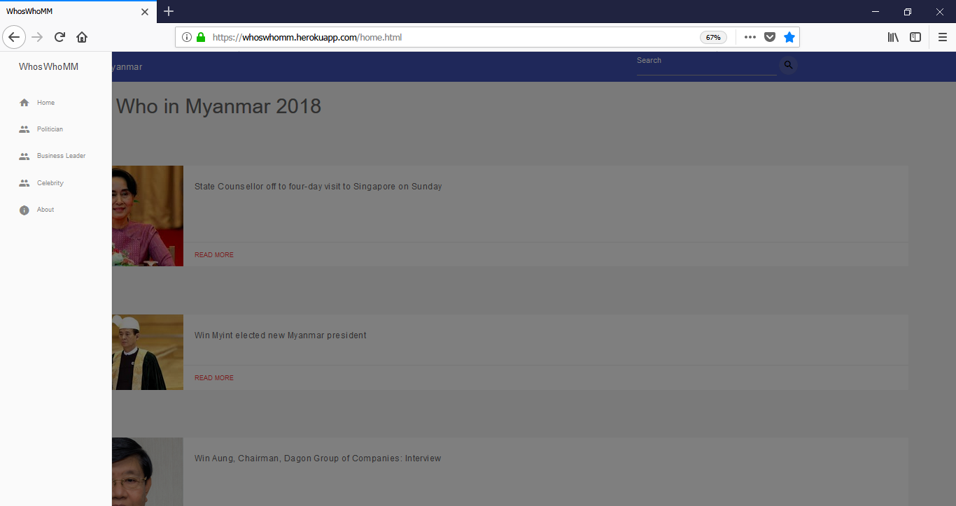
User Interface Design of Home Page with Navigation Drawer

Slide 34
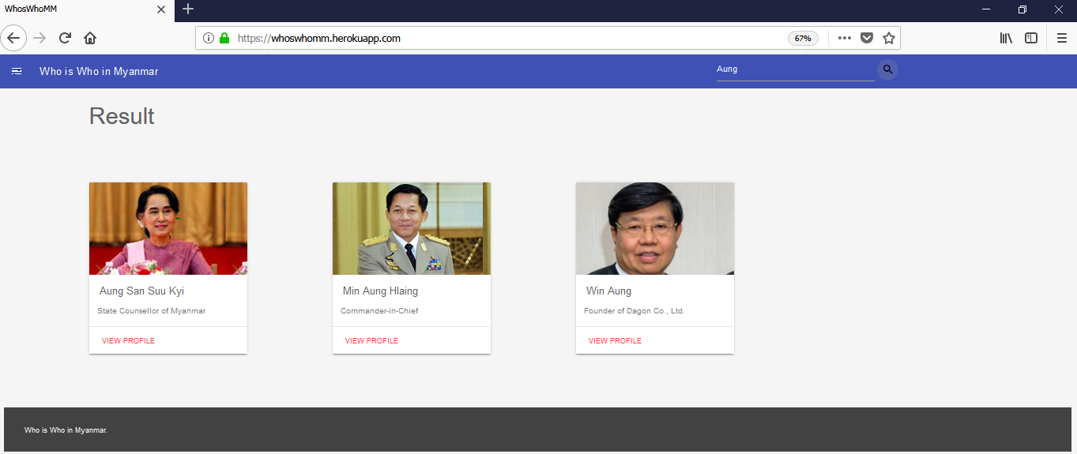
Searching is found

Slide 35
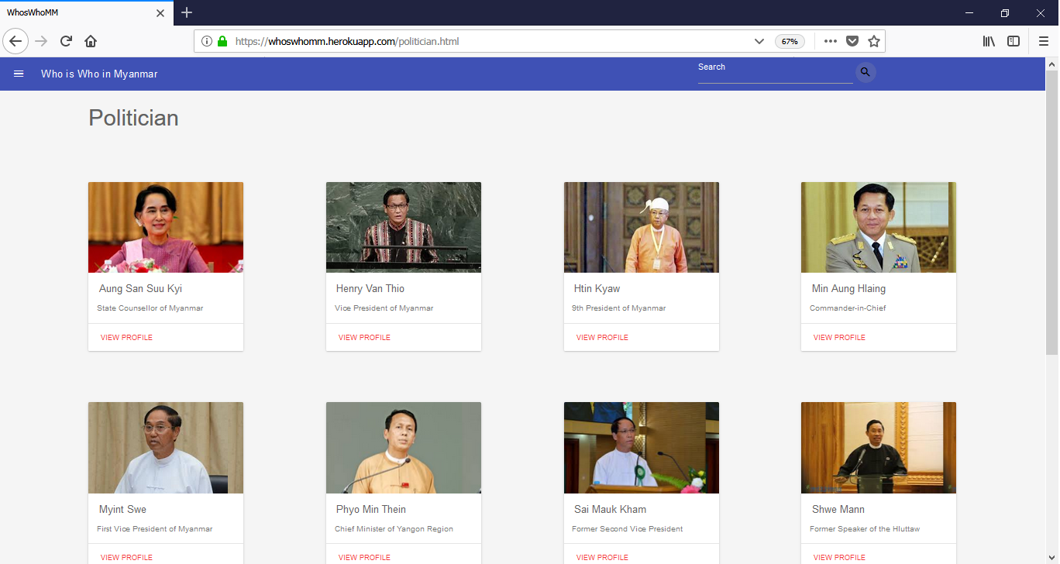
Politician Page

Slide 36
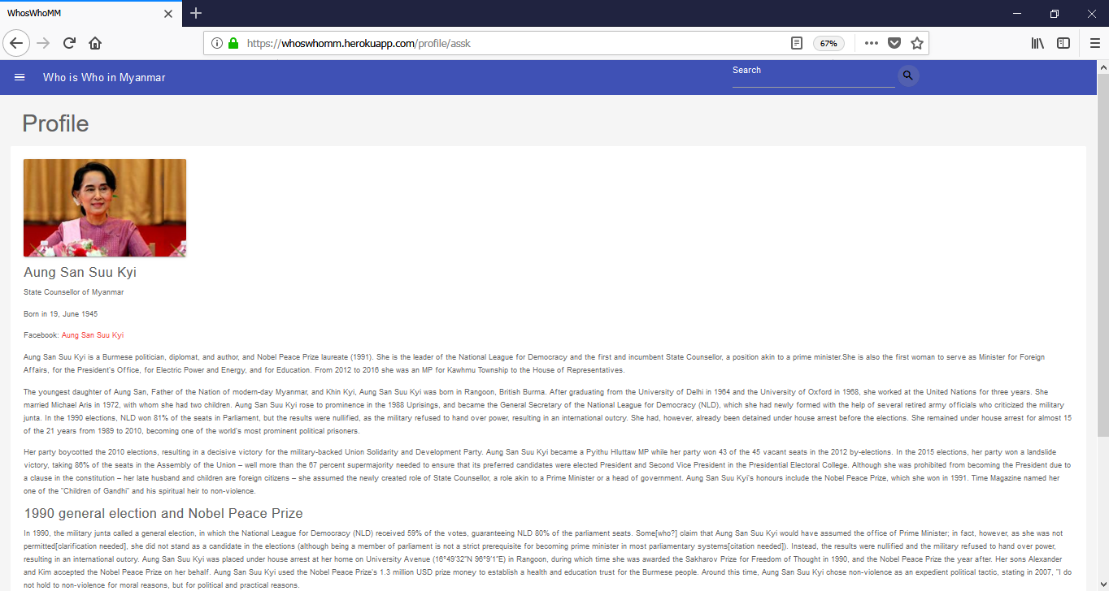
Politician View

Slide 37
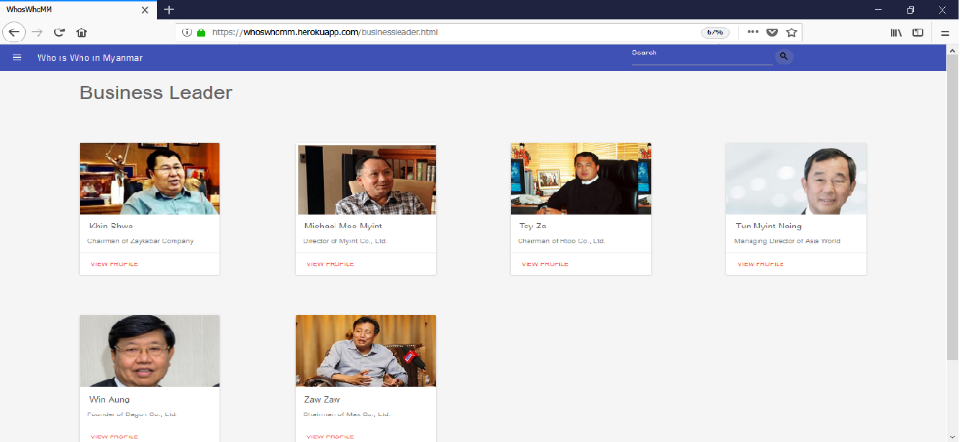
Business Page

Slide 38
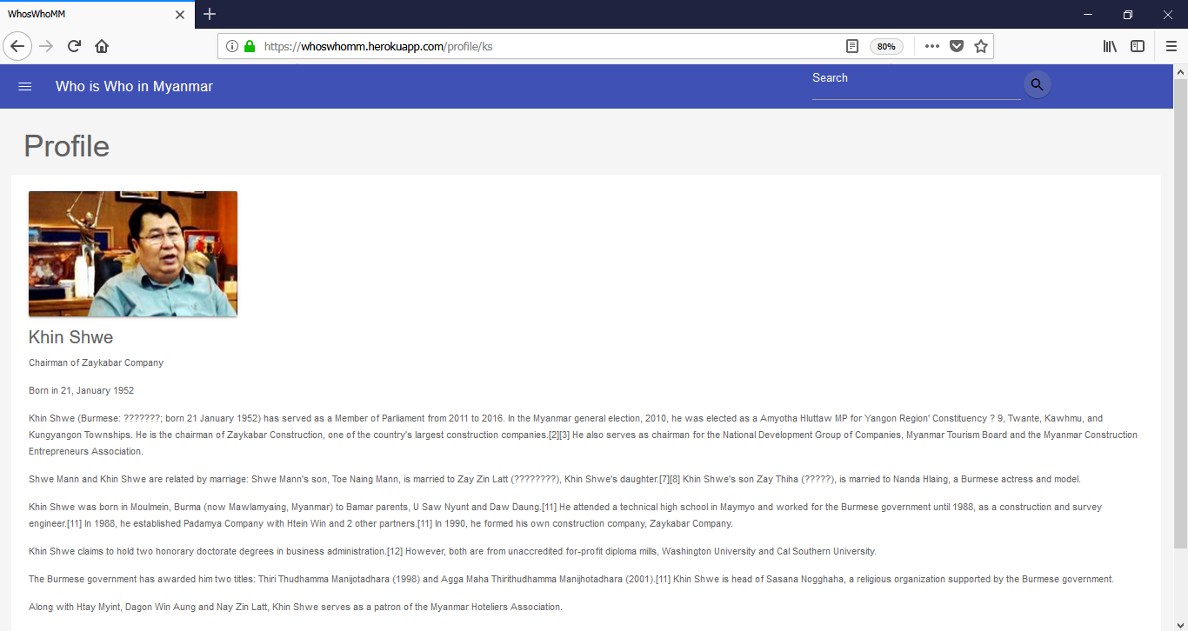
Business View

Slide 39
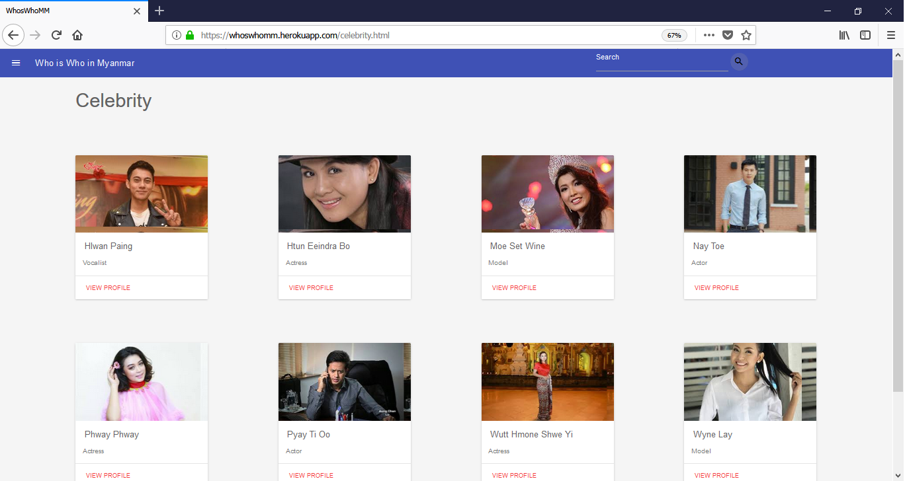
Celebrity Page

Slide 40
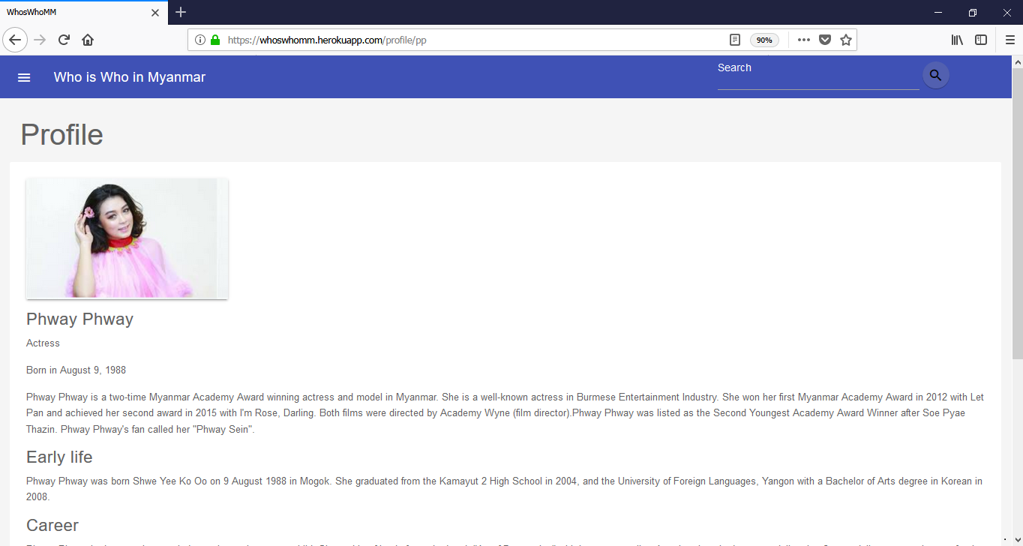
Celebrity View

Slide 41
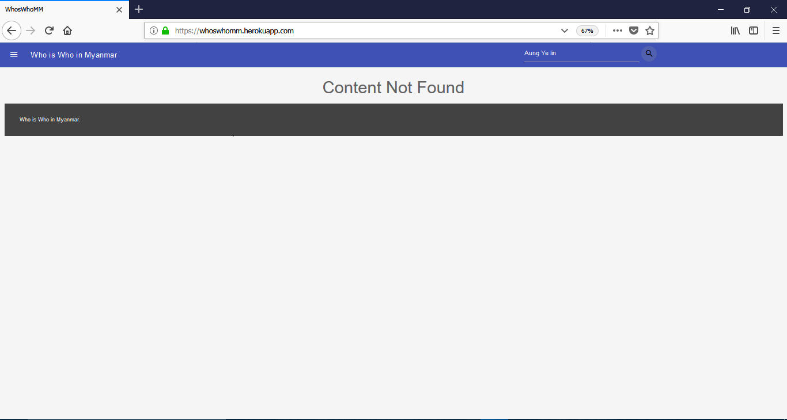
Searching is not found

Slide 42
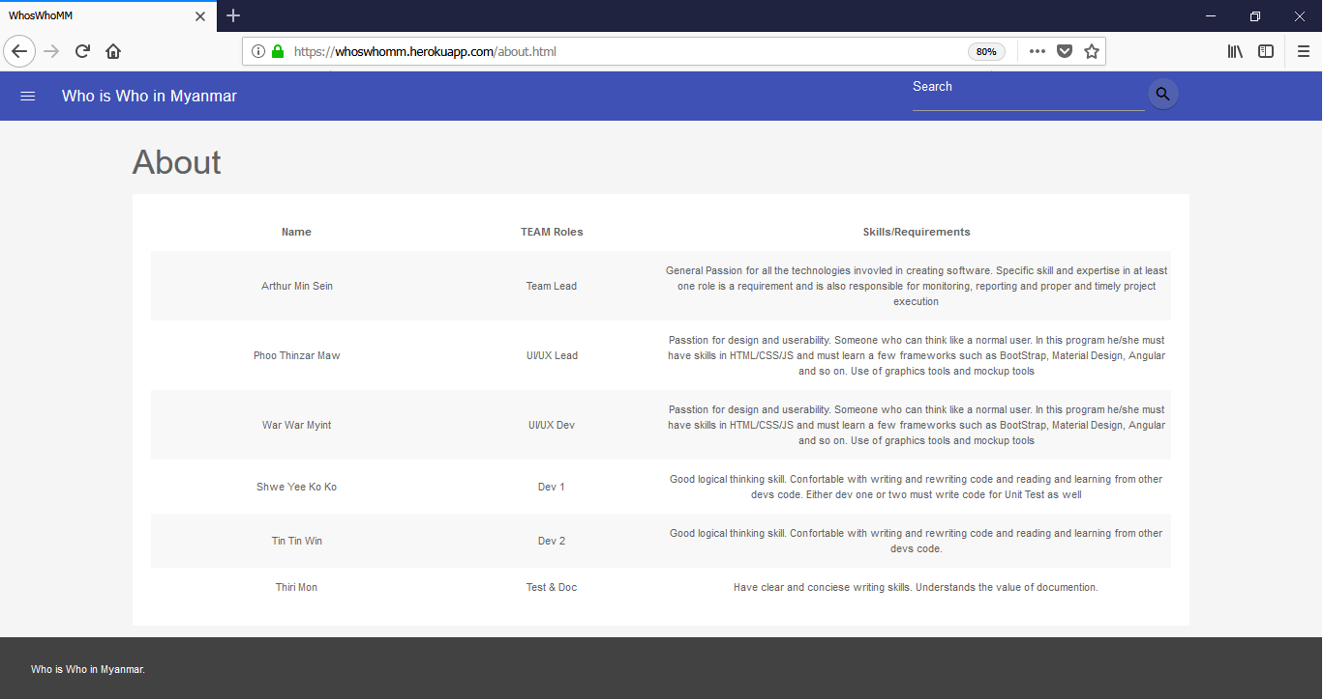
Sectors of Members

Slide 43
Conclusion
The system provides simple and complete functions for users without difficulty and save their time.
For users, they can get information on knowledge whenever they want, that offers the exact needs or update information in a month and so on.
User benefits would be brought using this system.

Slide 44
Advantages of the project
The proposed system offers the following advantages:
It provides “faster and better” service to users.
Finding information in a concise, easy way;
Learning and finding new things never heard of before and much more.
Provide an overview of user’s topic.
Disadvantage of the project
This website cannot work if there is no internet connection or wifi.

Slide 45
Limitation of the project
The system is implemented for only three sectors such as Politician,Business Leader and Celebrity.
So the system is not available for other sectors such as Author , Social Influencer, etc.
The system cannot select for sectors in searching of people.

Slide 46
FURTHER EXTENSION OF THE PROJECT
As our web design is responsive, the system can be implemented not only on PC but also on Mobile Phone.
The system can search people from different sectors.
Users can read the news about the current activity of famous people.
Hardware requirements
Mobile Phone
Personal Computer
Internet Acess
Software Requirements
Vim
Pycharm
Heroku
Python with Flask
Git Hub

Slide 47
Reference
https://www.wikipedia.org/
https://www.codecademy.com/learn/learn-git
https://www.codecademy.com/learn/learn-the-commandline
https://github.com/mayeedwin/profile
https://vim-adventures.com/
https://devcenter.heroku.com/
https://www.sqlalchemy.org/
http://flask.pocoo.org/docs/1.0/templating/
https://getmdl.io/
https://materializescss.com/
Our Website Link
https://whoswhomm.herokuapp.com/

Slide 48
Thank You For Your Attention

